Slide 1
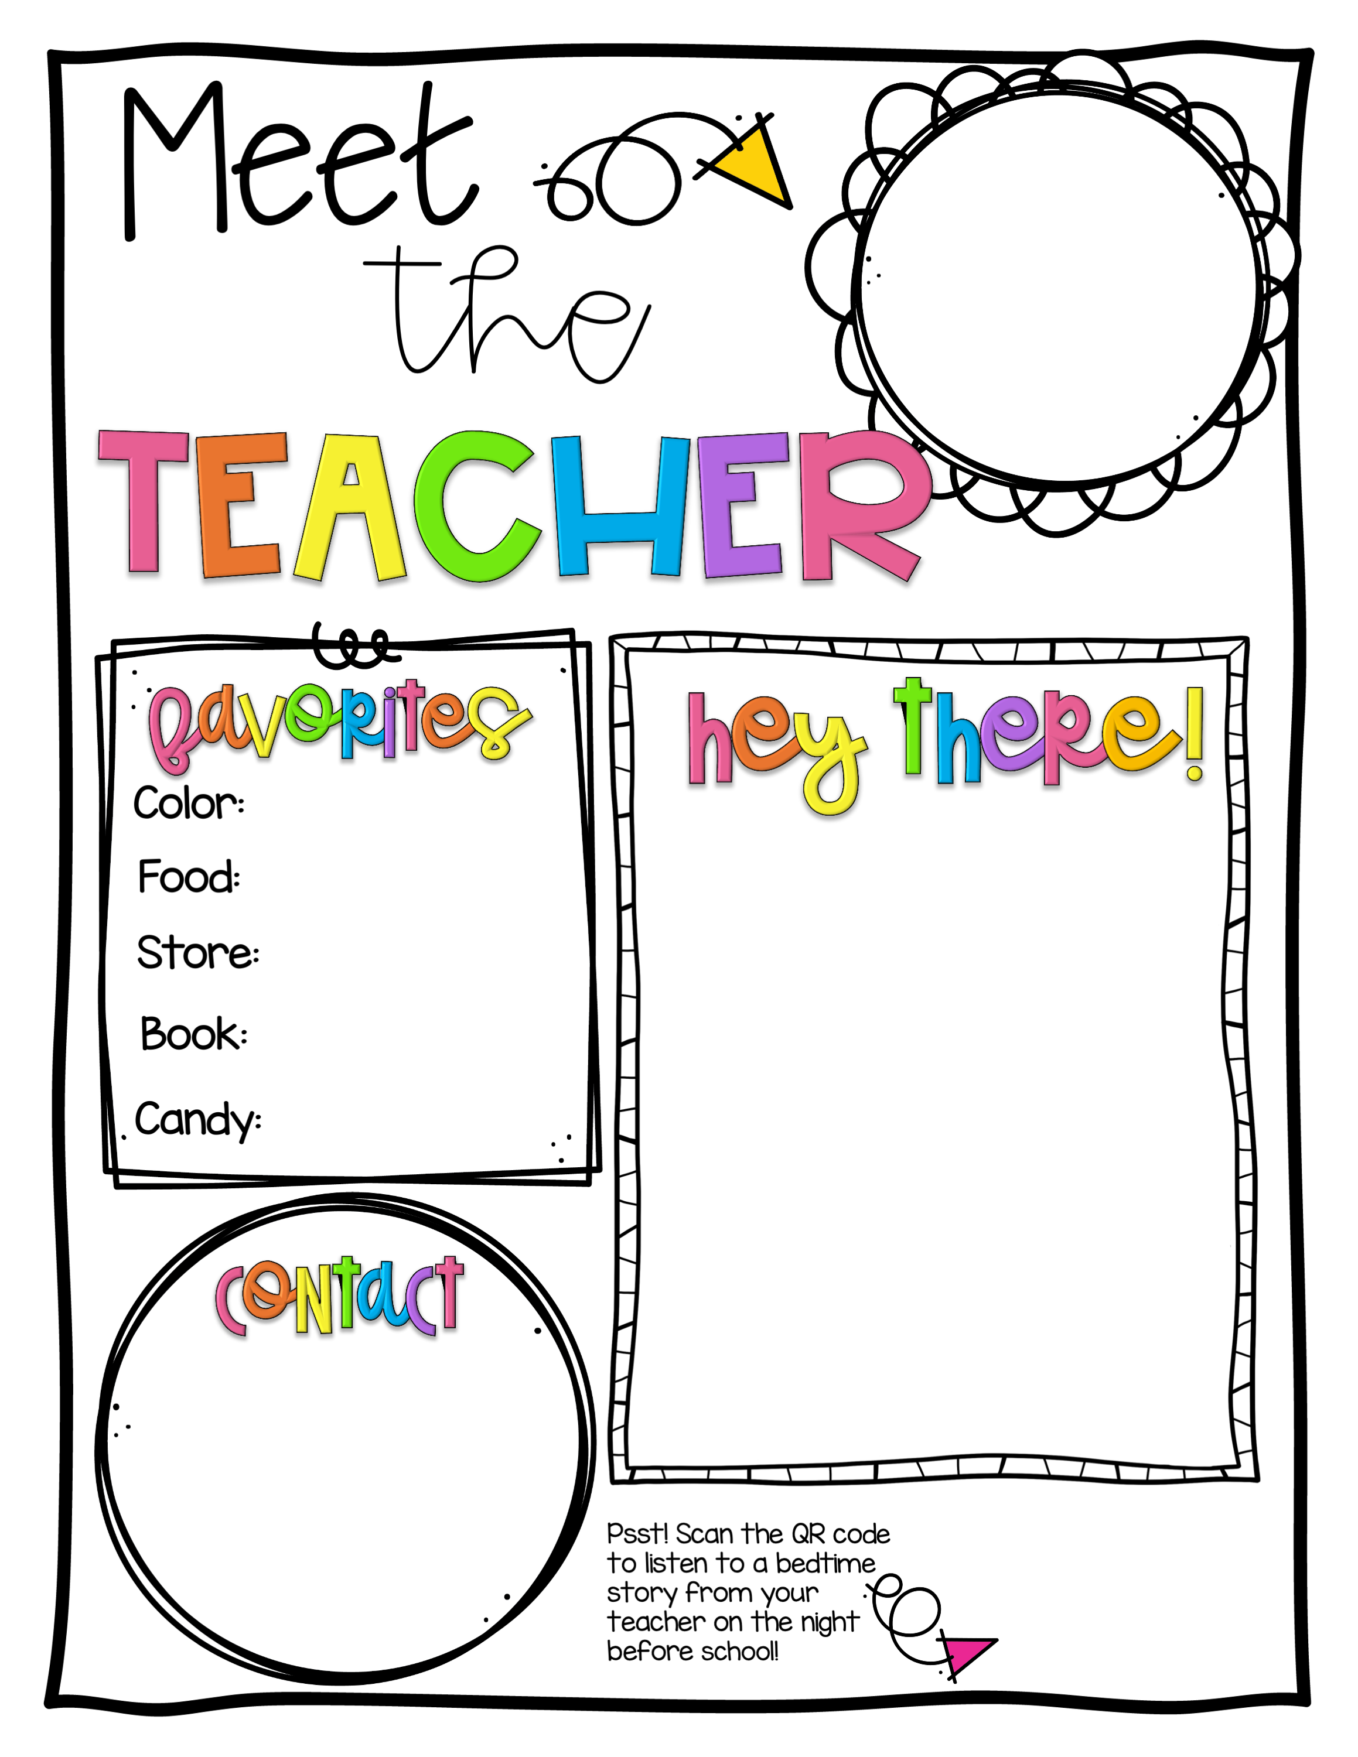
0
Olive Green
Mac-N-Cheese
Hi everyone! I am so excited to be able to play and learn with you all this year!
Snuggly Monkey
The Little Ghost Who Was a Quilt
Dark Chocolate
Lyndsey Webster
919-323-1633
lyndseydw@gmail.com
© Carolina Corner

Slide 2
0
Violet
Mexican
Hello to my new 3-year-old class! I am very excited to be your teacher this year. I look forward to meeting each one of you and working together to explore and learn. We will have lots of fun together as we start our adventure!
Target
Dr Seuss
Chocolate
Tatiana Braga
984-220-6245
tatianahug926@gmail.com
© Carolina Corner

Slide 3
0
Purple
Mediterranean
Hello everyone! I can’t wait to learn along with you this year! We’ll read lots of books, sing songs, do crafts, play together and explore the world around us. Let’s get started!
TJ Maxx
Miss Rumphius by Barbara Cooney
Mint Chocolate
Martha Anne Wright
336-469-4028
Martha.anne.wright@gmail.com
© Carolina Corner

Slide 4
0
Pink
Crabcakes/Pizza
I'm excited to be your teacher this year. I love children. I feel they make the world a better place! I feel like God put me in a classroom to show
children they're loved every day. I'm always here if you need to discuss anything. I look forward to a wonderful year!
Trader Joe’s
I Heard Said
the Bird
Peanut Butter
M&Ms.
Kimberly Herbst
919-219-1726
kimberly_herbst@
yahoo.com
© Carolina Corner

Slide 5
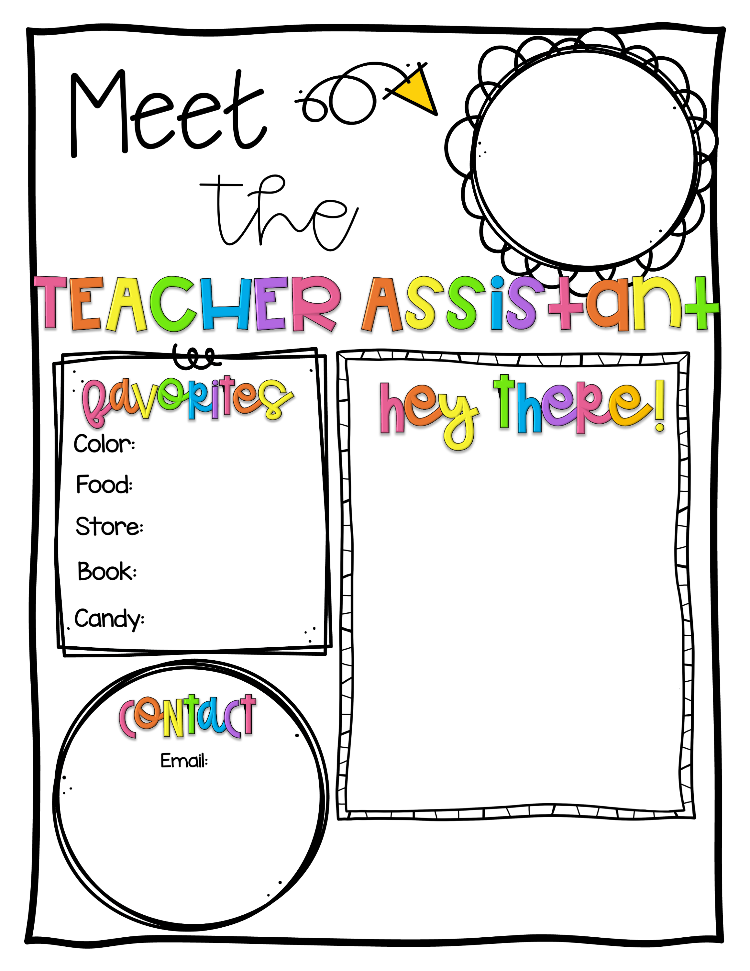
0
Orange
Sushi
Altar’d State or
TJ Maxx
I am so excited to get to know you and be a part of your growth journey! I am
passionate about early education and committed to
helping create a warm, supportive, and engaging environment.
Where the Wild
Things Are
Sour Patch Kids
Sadiedenehy@yahoo.com
© Carolina Corner

Slide 6
0
Green
Pho
Target
I am so excited to get to meet and know all the kids!!!
If You Give a Mouse a Cookie
Anything Sour
naomigw383@gmail.com
© Carolina Corner

Slide 7

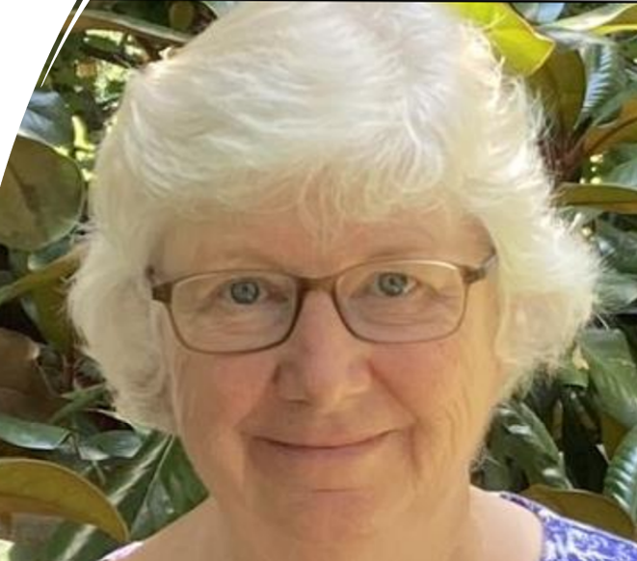

Welcome to a new year of learning and playing together at McMannen!
I will miss teaching my class of wonderful four-year-olds but I’m looking forward to my new role as Director. This way, I get the pleasure of interacting with all of you in and around the school! What a treat that will be!
We’re planning lots of learning experiences for you so let’s get started!
Color: Purple
Food: Mediterranean
Store: TJ Maxx
Book: Miss Rumphius
Candy: Mint Chocolates
Martha Anne Wright
336-469-4028
martha.anne.wright@gmail.com

